Slide 1
GENERATION OF COMPUTERS
-Prashim Timsina

Slide 2
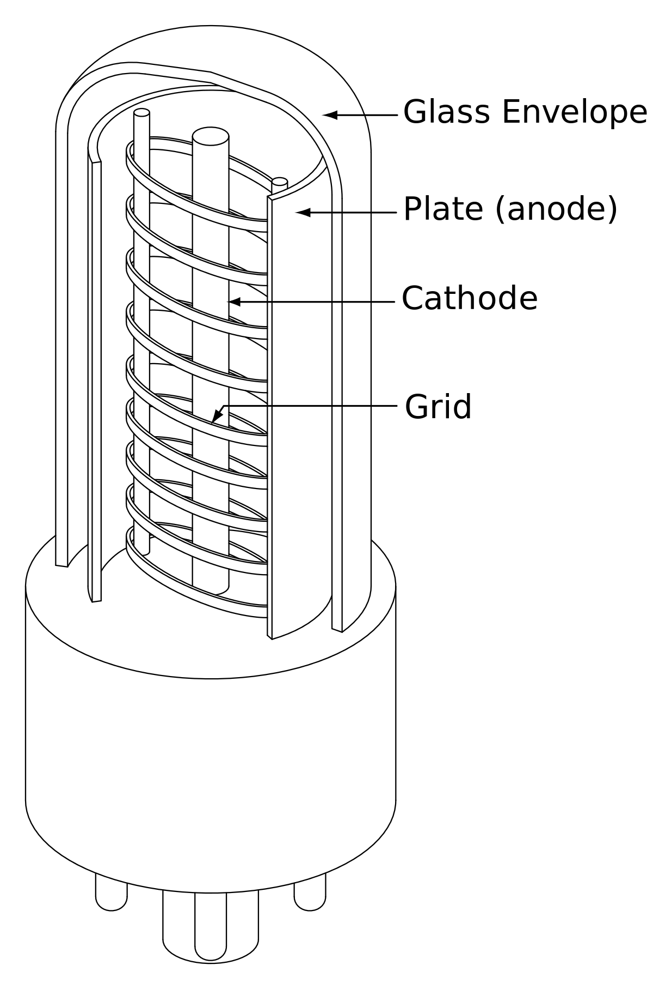
FIRST GENEREATION (1940-1956)
These computers were based on vacuum tube technology.
Their speed was measured in terms of millisecond.
Punched cards were used as input devices.
Binary or Machine language was the main language.
Fixed point arithmetic calculation was used.
Example: IBM 700 series, ENIAC, EDVAC, UNIVAC , etc.

Slide 3
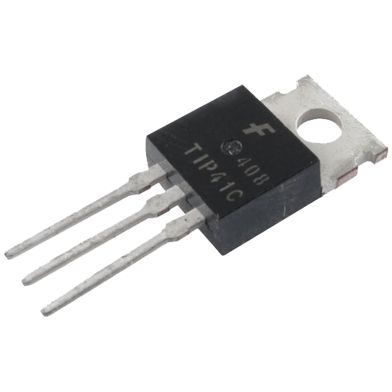
SECOND GENERATION (1956-1963)
These computers were based on transistors technology.
The processing speed was measured in millisecond.
Assembly language was used as main programming language.
They also worked on punched cards as input devices.
Example: IBM 1401, IBM 7090, PDP 8, etc.

Slide 4
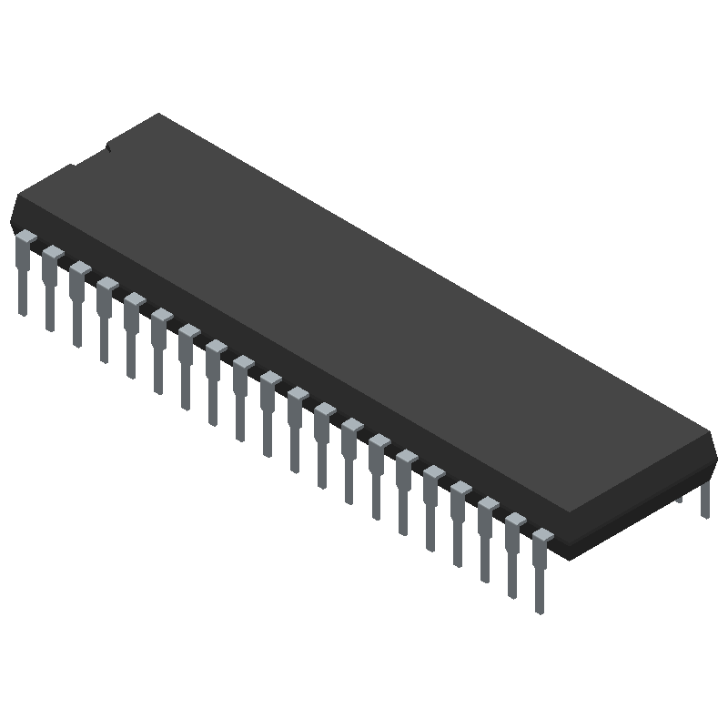
THIRD GENERATION (1964-1970s)
These computers were based on integrated circuit(IC) technology.
Semiconductor memory was used as primary memory.
Magnetic disk was used as secondary memory.
Keyboard and monitors were used as input and output devices.
Processing speed was measured in nanoseconds.
High level languages were used as programming languages.

Slide 5
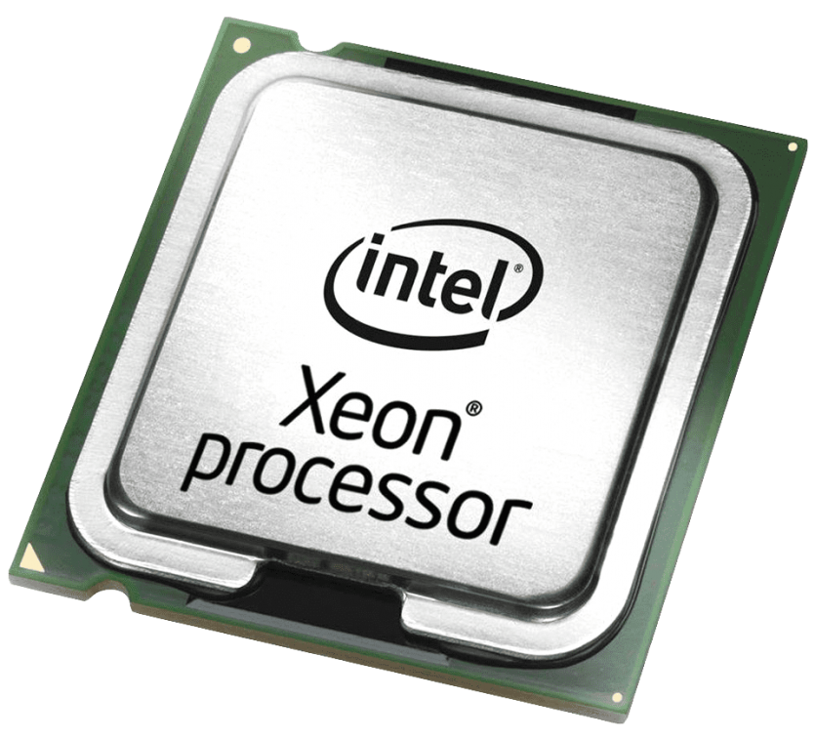
FOURTH GENERATION (1970s-Today)
These computers are based on microprocessor technology.
Its processing speed is measured in terms of picosecond.
Use of magnetic and optical disk were used as secondary storage devices
It used graphical user interface (GUI) and user interface.
Application software were also popular during this period.
Example: Apple II, Altair 8800, CRAY-1, etc.

Slide 6
THANK YOU!!

